Slide 1
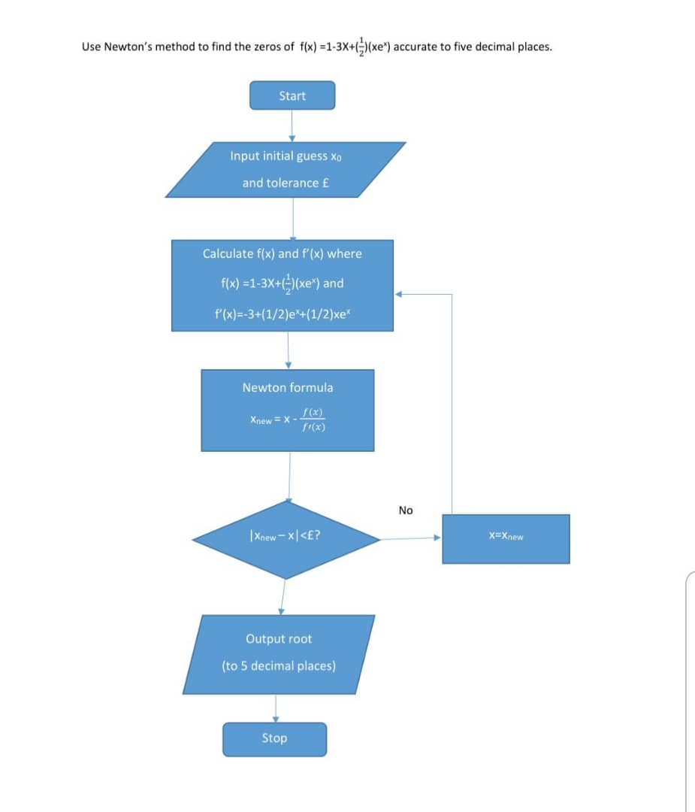
NEWTON RAPHSON METHOD 2

Slide 2
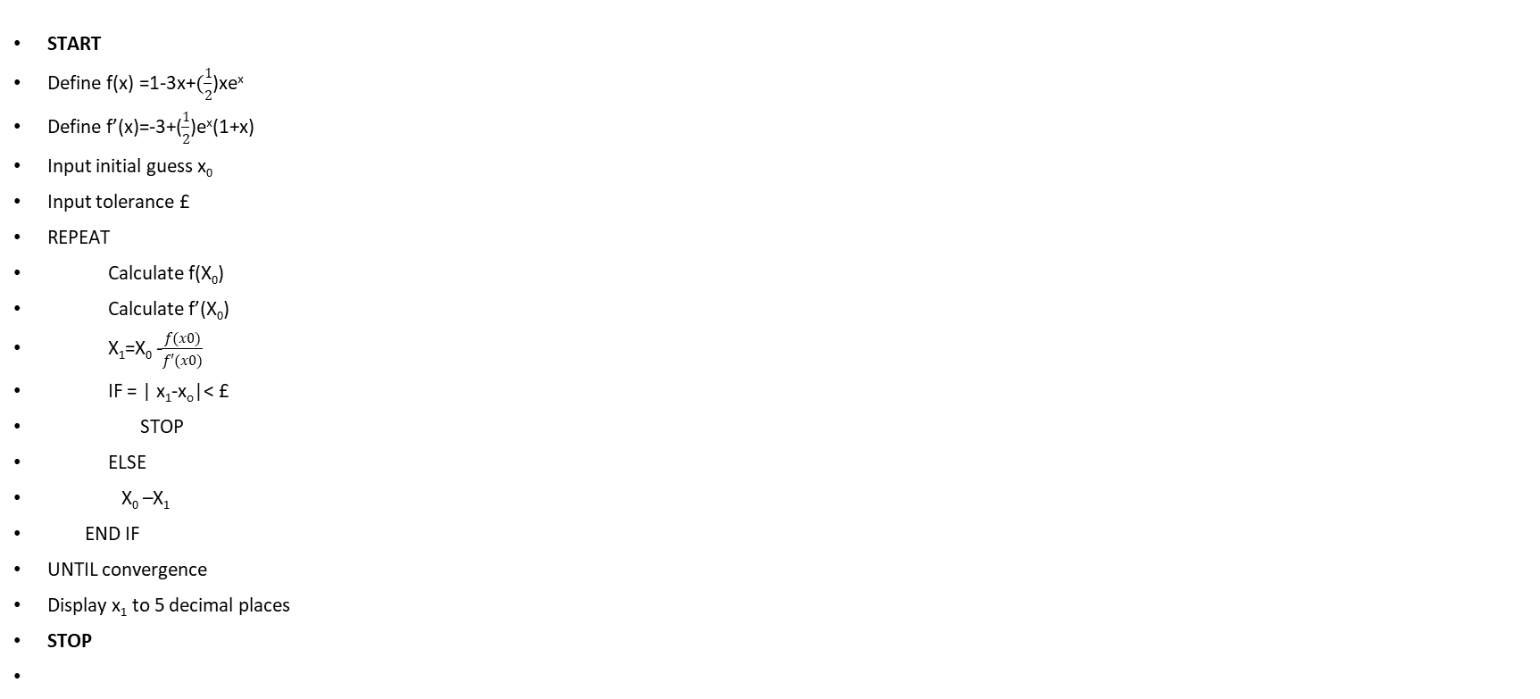
PSEUDOCODE
START
Define f(x) =1-3x+$(\frac{1}{2}$)xe^{x}
Define f’(x)=-3+($\frac{1}{2}$)e^{x}(1+x)
Input initial guess x₀
Input tolerance £
REPEAT
Calculate f(X₀)
Calculate f’(X₀)
X₁=X₀ -$\frac{f(x0)}{f′(x0)}$
IF = | x₁-x_{o}|< £
STOP
ELSE
X₀ –X₁
END IF
UNTIL convergence
Display x₁ to 5 decimal places
STOP

Slide 3
‘FOR’ AND ‘WHILE’ LOOP
f=@(x) 1-3*x + 0.5*x*exp(x);
df=@(x)-3+0.5*exp(x)*(1+x);
x0 = 0;
tol=0.000001;
N=100;
for i = 1:N
X1 = X0-f(x0)/df(x0);
if abs(x1-x0)<tol
end
x0=x1;
end
fprintf('Root=%.5f/n',x1);
fprintf('Iterations =%d/n',i);
while i<N
X1 =X0-f(x0)/df(x0);
i=i+1;
if abs(x1-x0)<tol
end
x0=x1;
end
fprintf('Root=%.5f/n',x1);
fprintf('Iterations =%d/n',i);

Slide 4
MATLAB CODE
f=@(x)1-3*x +0.5*x.*exp(x);
df =@(x)-3+0.5*exp(x).*(1+x);
x0=0;
tol=1e-6;
maxiter=100;
for i=1:maxiter
x1=x0-f(x0)/df(x0);
if abs(x1-x0)<tol
break;
end
x0=x1;
end
fprintf('Root=%.5f/n',x1);
fprintf('Number of iterations=%d/n',i);

